Slide 1

Circular Convolution
Chiranjeevi Yarra
06 / 04/ 2026

Slide 2
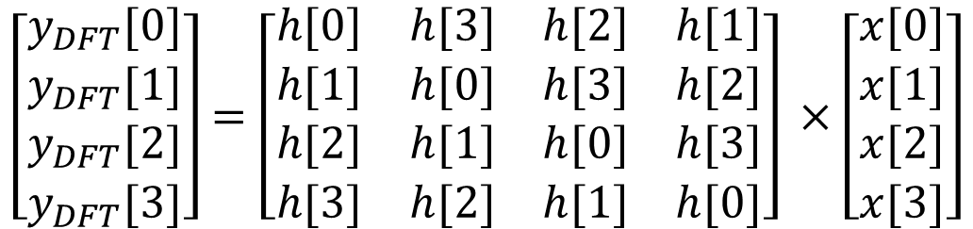
Matrix multiplication form of circular convolution
$$\left[\begin{matrix}y_{DFT}[0] \\ y_{DFT}[1] \\ \begin{matrix}y_{DFT}[2] \\ y_{DFT}[3]\end{matrix}\end{matrix}\right]=\left[\begin{matrix}\begin{matrix}h[0] & h[3] \\ h[1] & h[0]\end{matrix} & \begin{matrix}h[2] & h[1] \\ h[3] & h[2]\end{matrix} \\ \begin{matrix}h[2] & h[1] \\ h[3] & h[2]\end{matrix} & \begin{matrix}h[0] & h[3] \\ h[1] & h[0]\end{matrix}\end{matrix}\right] ×\left[\begin{matrix}x[0] \\ x[1] \\ \begin{matrix}x[2] \\ x[3]\end{matrix}\end{matrix}\right]$$

Slide 3
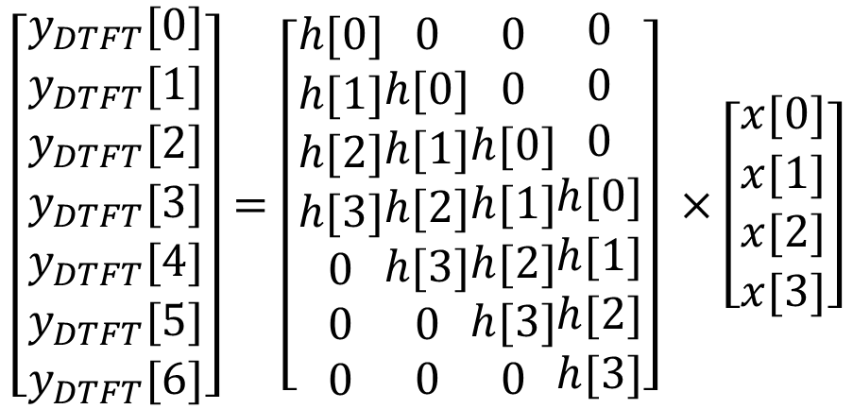
Matrix multiplication form of convolution
$$\left[\begin{aligned}\begin{matrix}y_{DTFT}[0] \\ y_{DTFT}[1] \\ \begin{matrix}y_{DTFT}[2] \\ y_{DTFT}[3]\end{matrix}\end{matrix} \\ y_{DTFT}[4] \\ y_{DTFT}[5] \\ y_{DTFT}[6]\end{aligned}\right]=\left[\begin{aligned}h[0] \\ h[1] \\ h[2] \\ h[3] \\ 0 \\ 0 \\ 0\end{aligned}\begin{aligned}0 \\ h[0] \\ h[1] \\ h[2] \\ h[3] \\ 0 \\ 0\end{aligned}\begin{aligned}0 \\ 0 \\ h[0] \\ h[1] \\ h[2] \\ h[3] \\ 0\end{aligned}\begin{aligned}0 \\ 0 \\ 0 \\ h[0] \\ h[1] \\ h[2] \\ h[3]\end{aligned}\right] ×\left[\begin{matrix}x[0] \\ x[1] \\ \begin{matrix}x[2] \\ x[3]\end{matrix}\end{matrix}\right]$$

Slide 4
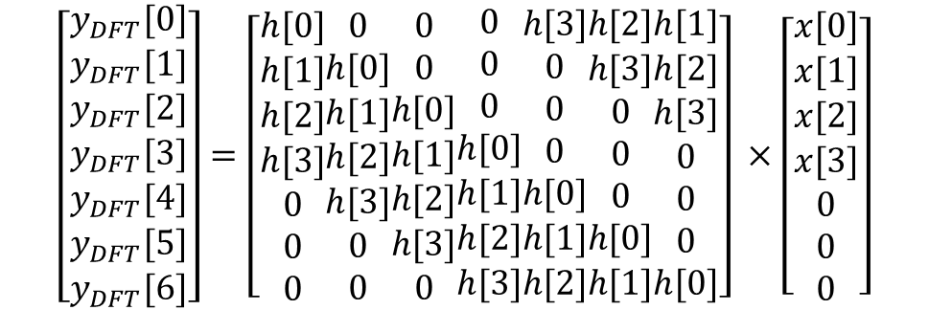
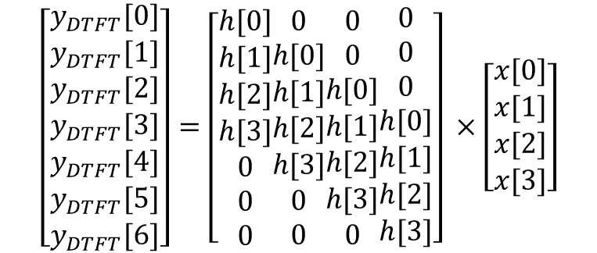
Linear convolution from circular convolution
$$\left[\begin{aligned}\begin{matrix}y_{DTFT}[0] \\ y_{DTFT}[1] \\ \begin{matrix}y_{DTFT}[2] \\ y_{DTFT}[3]\end{matrix}\end{matrix} \\ y_{DTFT}[4] \\ y_{DTFT}[5] \\ y_{DTFT}[6]\end{aligned}\right]=\left[\begin{aligned}h[0] \\ h[1] \\ h[2] \\ h[3] \\ 0 \\ 0 \\ 0\end{aligned}\begin{aligned}0 \\ h[0] \\ h[1] \\ h[2] \\ h[3] \\ 0 \\ 0\end{aligned}\begin{aligned}0 \\ 0 \\ h[0] \\ h[1] \\ h[2] \\ h[3] \\ 0\end{aligned}\begin{aligned}0 \\ 0 \\ 0 \\ h[0] \\ h[1] \\ h[2] \\ h[3]\end{aligned}\right] ×\left[\begin{matrix}x[0] \\ x[1] \\ \begin{matrix}x[2] \\ x[3]\end{matrix}\end{matrix}\right]$$
$$\left[\begin{aligned}\begin{matrix}y_{DFT}[0] \\ y_{DFT}[1] \\ \begin{matrix}y_{DFT}[2] \\ y_{DFT}[3]\end{matrix}\end{matrix} \\ y_{DFT}[4] \\ y_{DFT}[5] \\ y_{DFT}[6]\end{aligned}\right]=\left[\begin{aligned}h[0] \\ h[1] \\ h[2] \\ h[3] \\ 0 \\ 0 \\ 0\end{aligned}\begin{aligned}0 \\ h[0] \\ h[1] \\ h[2] \\ h[3] \\ 0 \\ 0\end{aligned}\begin{aligned}0 \\ 0 \\ h[0] \\ h[1] \\ h[2] \\ h[3] \\ 0\end{aligned}\begin{aligned}0 \\ 0 \\ 0 \\ h[0] \\ h[1] \\ h[2] \\ h[3]\end{aligned}\begin{aligned}h[3] \\ 0 \\ 0 \\ 0 \\ h[0] \\ h[1] \\ h[2]\end{aligned}\begin{aligned}h[2] \\ h[3] \\ 0 \\ 0 \\ 0 \\ h[0] \\ h[1]\end{aligned}\begin{aligned}h[1] \\ h[2] \\ h[3] \\ 0 \\ 0 \\ 0 \\ h[0]\end{aligned}\right] ×\left[\begin{matrix}x[0] \\ x[1] \\ \begin{matrix}x[2] \\ \begin{aligned}x[3] \\ 0 \\ 0 \\ 0\end{aligned}\end{matrix}\end{matrix}\right]$$

Slide 5

Thank you

